Slide 1
Reader Writer
Java readers and writers are character-based streams.
Reader ត្រូវបានប្រើនៅពេលយើងចង់ read ពពួក character-based data ពី data source មួយ
Writer ត្រូវបានប្រើនៅពេលយើងចង់ write ពពួក character-based data.

Slide 2
Constructor & Description
protected Reader()
បង្កើត character-stream reader ថ្មីមួយដែល critical sectionsរបស់វានឹងធ្វើការ synchronize នៅលើ reader របស់ខ្ឡួនវា.
protected Reader(Object lock)
បង្កើត character-stream reader​ ថ្មីមួយដែល critical sectionsរបស់វានឹងធ្វើការ synchronize នៅលើ given object.

Slide 3
Method
abstract void close() void mark(int readAheadLimit) boolean markSupported() int read() int read(char[] cbuf) | abstract int read(char[] cbuf, int off, int len) int read(CharBuffer target) boolean ready() void reset() long skip(long n)

Slide 4
Constructor & Description
protected Writer() បង្កើត character-stream writer ថ្មីមួយដែល critical sections របស់វានឹងធ្វើការ synchronize នៅលើ writer របស់ខ្ឡួនវា. | protected Writer(Object lock) បង្កើត character-stream writer​ ថ្មីមួយដែល critical sectionsរបស់វានឹងធ្វើការ synchronize នៅលើ given object.

Slide 5
Method
Writer append(char c) Writer append(CharSequence csq) Writer append(CharSequence csq, int start, int end) abstract void close() abstract void flush() | void write(char[] cbuf) abstract void write(char[] cbuf, int off, int len) void write(int c) void write(String str) void write(String str, int off, int len)

Slide 6
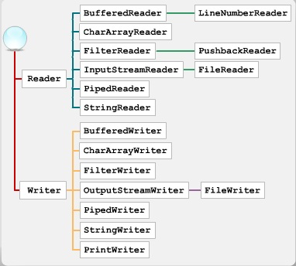
1. ការណែនាំអំពី​ Java
[Khmer OS Battambang: 30 Bold]

Slide 7
10. ប្រភពឯកសារ
https://www.tutorialspoint.com/java/io/java_io_writer.htm
https://www.tutorialspoint.com/java/io/java_io_reader.htm
http://javadevwannabe.blogspot.com/2012/02/reader-and-writer-classes.html

